Slide 1
CACD MINI PROJECT
Security Log Analyzer &
Anomaly Detector
Cryptanalysis and Cyber Defence (CACD)
2420030251 Meduri Rakesh Kumar
2420030650 Kanchi Veera Venkata Ganesh
2420030576 Enumula Hitesh

Slide 2
Objectives
Structured Log Pipeline
Log Integrity (SHA-256)
Collect and parse auth, firewall, and system logs into a structured, analyzable format.
Chain-hash every log entry so tampering or deletion of past records is cryptographically detectable.
Behavioral Features
Rule-Based Detection
Extract login frequency, failed attempts, IP patterns, access time, and Shannon entropy of log strings.
Threshold rules for known attack patterns — brute force, blacklisted IPs, off-hour access.
Statistical Anomaly Detection
Severity-Tagged Alerts & Dashboard
Z-score analysis on rolling feature windows to catch deviations — no ML training needed.
Actionable Low/Medium/High alerts, visualized with trends and integrity status.
Security Log Analyzer & Anomaly Detector | CACD Mini Project
2

Slide 3
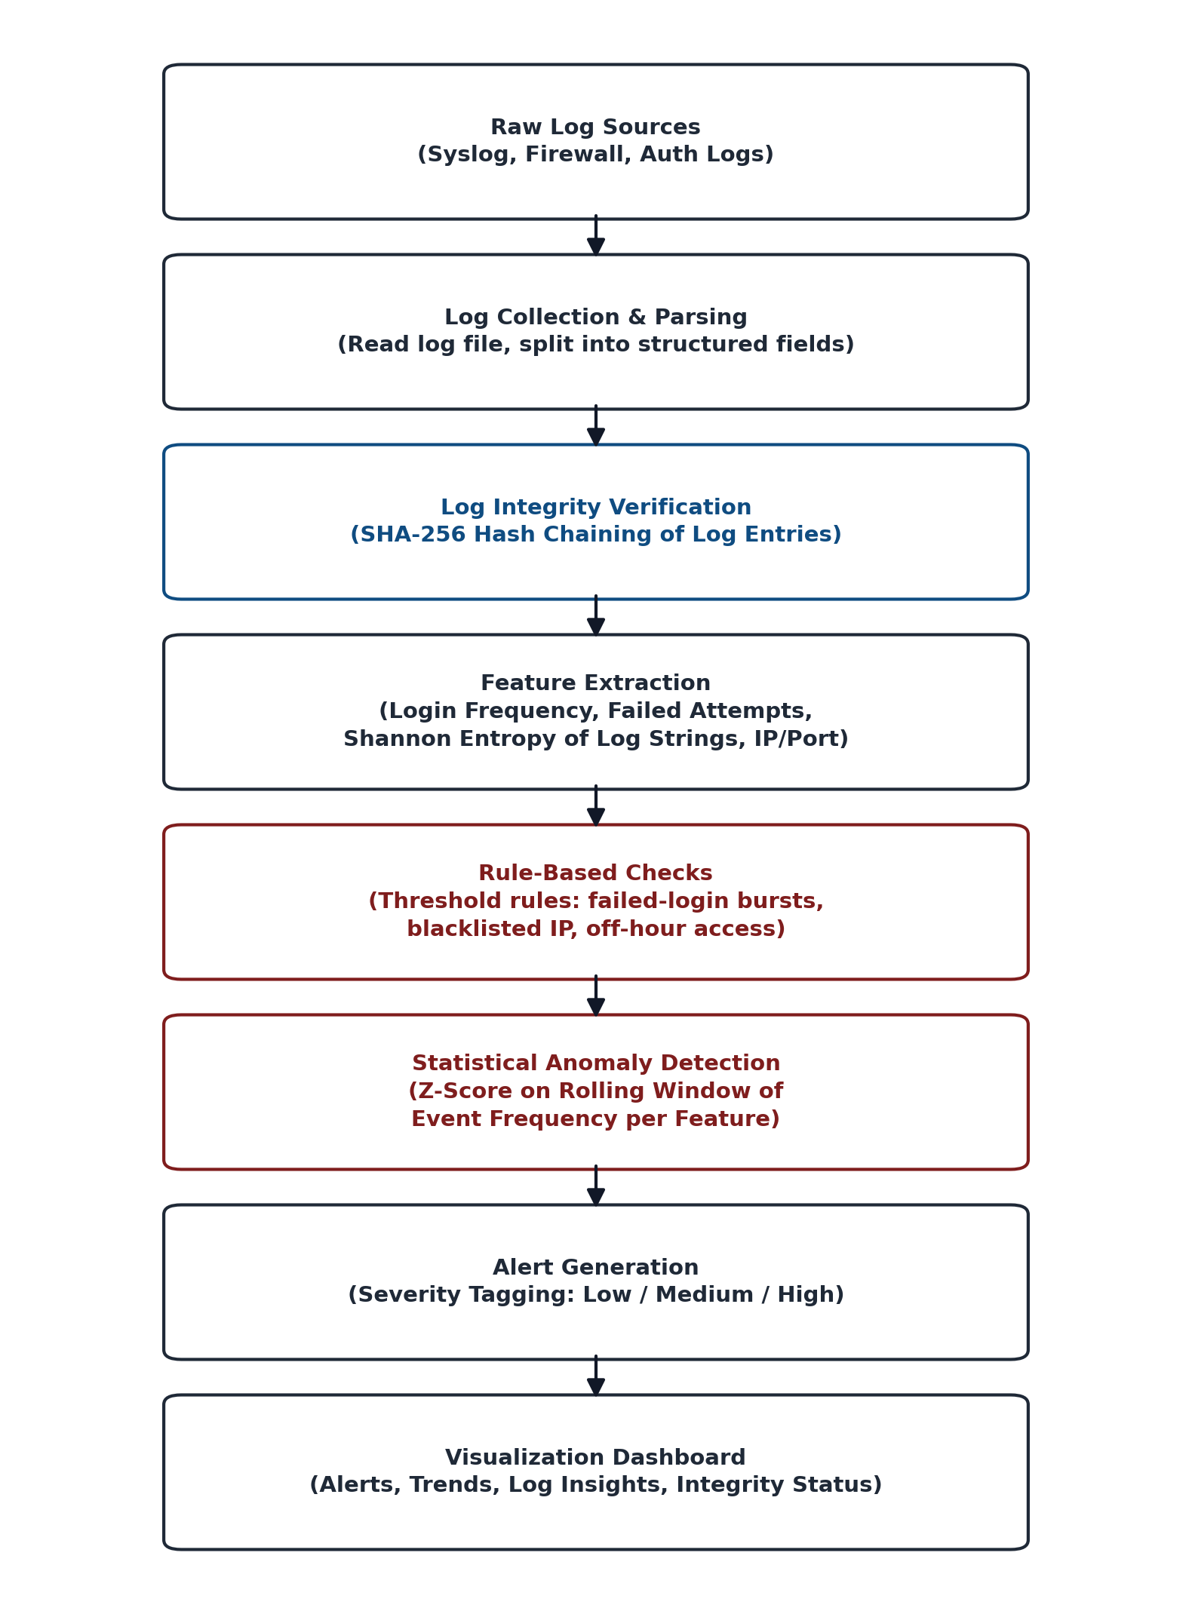
System Pipeline
End-to-end flow: log ingestion → integrity check → feature extraction → detection → alerting
Security Log Analyzer & Anomaly Detector | CACD Mini Project
3

Slide 4
Log Integrity — SHA-256 Hash Chaining
The cryptography layer that ties this project back to CACD
How it works
Why it matters
Each log entry gets a SHA-256 hash combined with the previous entry's hash.
hash(n) = SHA256( entry(n) + hash(n−1) )
This chains every entry together — the same principle used in blockchain ledgers.
To verify integrity, recompute the chain and compare to stored hashes.
Any mismatch → immediate High-severity ‘Log Tampering Detected’ alert.
Protects the evidentiary value of logs, not just the events they describe.
Detects deletion, editing, or reordering of past entries by an attacker covering their tracks.
Requires no external library — Python's built-in hashlib module handles it.
Tested by deliberately editing a past entry and confirming the chain breaks.
Security Log Analyzer & Anomaly Detector | CACD Mini Project
4

Slide 5
Detection Methods
No model training required — fast to build, easy to justify
1. Rule-Based Checks
2. Z-Score Anomaly Detection
3. Shannon Entropy (Cryptanalysis)
> 5 failed logins in 60 seconds
Source IP on blacklist
Access outside 9 AM–9 PM
Rolling mean (μ) & std dev (σ)
Z = (x − μ) / σ
Flag if |Z| > 3
H(X) = −Σ p(x)·log₂ p(x)
High entropy → encoded/obfuscated payload
Feeds into feature set
Combined severity tagging: High = tampering detected OR both rule + Z-score triggered • Medium = one method triggered • Low = borderline Z-score
Security Log Analyzer & Anomaly Detector | CACD Mini Project
5

Slide 6
Dataset
NSL-KDD (Primary)
CICIDS2017 (Supporting)
Loghub (Optional)
Labeled network connection records — Normal vs. DoS, Probe, R2L, U2R attacks. Standard IDS benchmark.
Modern realistic traffic with Brute Force, DoS, DDoS, Botnet & Web attacks.
Real-world system log datasets — SSH, Apache, Linux, Windows — for SIEM-style testing.
unb.ca/cic/datasets/nsl.html
unb.ca/cic/datasets/ids-2017.html
github.com/logpai/loghub
Datasets are free and publicly downloadable — official pages or Kaggle mirrors (free account, no payment required).
Security Log Analyzer & Anomaly Detector | CACD Mini Project
6

Slide 7
Tools & Tech Stack
Entirely free and open-source — no paid tools, licenses, or APIs
pandas / numpy
hashlib (built-in)
Log parsing, rolling windows, Z-score & entropy calculation
SHA-256 hash chaining for log integrity verification
Streamlit
NSL-KDD / Loghub
Interactive dashboard — alerts, trends, integrity status
Free, publicly downloadable benchmark datasets
Security Log Analyzer & Anomaly Detector | CACD Mini Project
7

